Slide 1
Customer Segmentation of Olist Ecommerce Customers in Sao Paolo using K-Means Method.
By : Nicholas Nehemia
Student of jcdsah-bsd

Slide 2
What is Customer Segmentation?
Market segmentation can be defined as dividing a market into distinct groups of customers, with different needs, characteristics or behavior, who might require separate products or who may respond differently to various combinations of marketing efforts (Kotler & Armstrong, 1999). In segmenting customers, various criteria can also be used depending on the market such as geographic, demographic characteristics or behavior bases. This technique assumes that groups with different features require different approaches to marketing and wants to figure out the groups who can boost their profitability the most.

Slide 3
Why is Customer Segmentation Important?
Optimation of Resources
Segmentation is critical because a company has limited resources, and must focus on how to best identify and serve its customers. Individual customer segments are characterized by a certain degree of within-group homogeneity that helps ensure that the members of a segment will respond in similar ways to marketing efforts.
Understanding Customer Positions and Movement:
A deeper understanding of customers has validated the value of focusing on them. It is now generally accepted that it costs about five times more to gain a new customer than to keep an existing one, and ten times more to get a dissatisfied customer back (Marcus C., 1998).
Rerunning the model over periods of time, we can see the growth of each cluster, and evaluate whether the marketing strategies we have employed are effective or not.
Increase Customer Retention and Decrease Customer Churn:
By using this method, we can see which customers are potential Customers and High Value Customers. Through Customer Relationship Management, we can hopefully convert Potential Customers into High Value Customers, and focus our energy into High Value Customers.

Slide 4
Problem Statement
We would like do drive down marketing cost through Targeted Marketing based on Customer Segmentation.

Slide 5
RFM Segmentation
RFM segments customers based on their behaviour. The 3 main components are :
Recency: How much time has elapsed since a customer’s last activity or transaction with the brand?
Frequency: How often has a customer transacted or interacted with the brand during a particular period of time?
Monetary: Also referred to as “monetary value,” this factor reflects how much a customer has spent with the brand during a particular period of time.

Slide 6
Why RFM works.
Customers who have purchased from you recently are more likely to respond to your next promotion than those whose last purchase was further in the past. This is a universal principle which has been found to be true in almost all industries: insurance, banks, cataloging, retail, travel, etc. It is also true that frequent buyers are more likely to respond than less frequent buyers. Big spenders often respond better than low spenders. (Arthur Hughes)

Slide 7
Data Used
For this Customer Segmentation Case, we use Brazzilian E-Commerce Public Dataset by Olist from Kaggle.

Slide 8
Workflow
Import Data from CSV
Merge Dataframes from each CSV using Relevant Column
Create RFM Matrix
Check Missing Values
Clustering
Cluster EDA

Slide 9
RFM Metrics Used
Arthur Hughes uses Equal Binning Frequency in his RFM Matrix, but in this case this method is inappropriate , as most of the data in Frequency (Over 14000 data /16000 of total data) has a value of 1. This will create multiple bins with the same value. So for this dataset , we used Quartiles of category, and for the Frequency category we use a special method.
def rfm_price(x):
lower_quartil=42.90
median=79.99
upper_quartil=149.81
if x<=lower_quartil:
val=1
elif lower_quartil<x<=median:
val=2
elif median<x<=upper_quartil:
val=3
else:
val=4
return val
def rfm_freq(x):
lower_quartil=2
median=3
upper_quartil=4
if x<=lower_quartil:
val=1
elif lower_quartil<x<=median:
val=2
elif median<x<=upper_quartil:
val=3
else:
val=4
return val
def rfm_recency(x):
lower_quartil=-336.0
median=-209.0
upper_quartil=-112.0
if x<=lower_quartil:
val=1
elif lower_quartil<x<=median:
val=2
elif median<x<=upper_quartil:
val=3
else:
val=4
return val

Slide 10
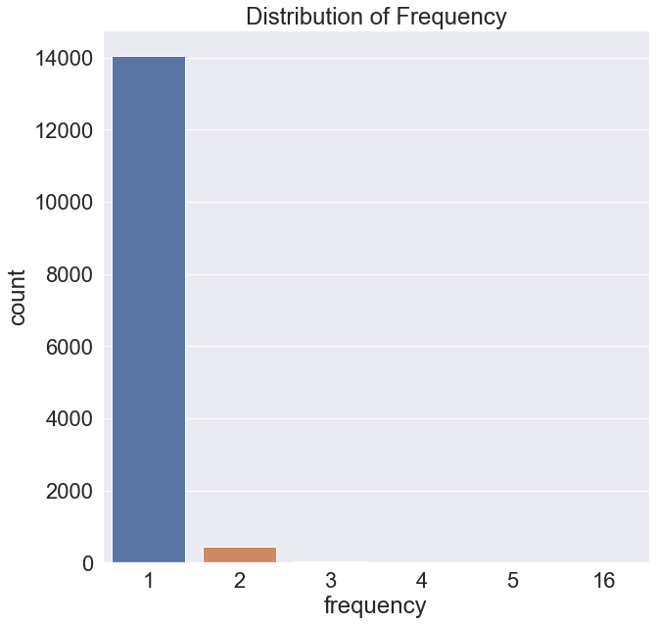
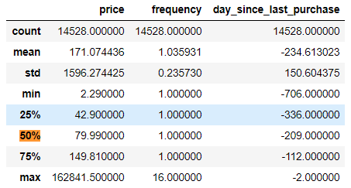
Frequency Metric
From the Frequency metric, we can see that the 1 and 2 far outshine the other value, causing both the mean , and median , and quartiles to have a value of one. That is why we use the RFM as before.

Slide 11
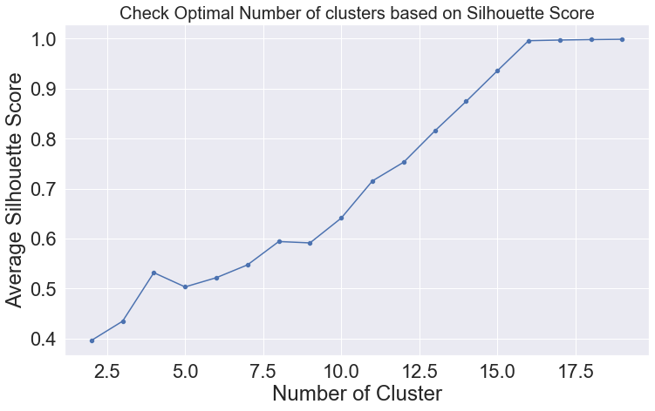
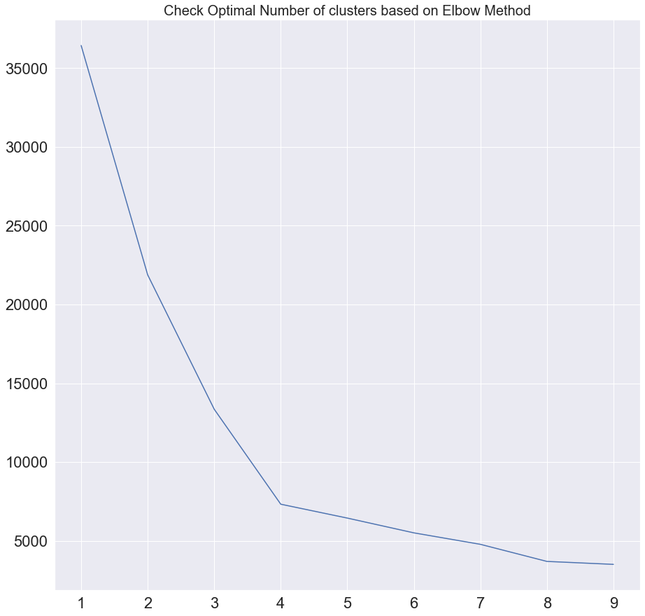
Validation Metrics Used

Slide 12
Validation Metrics Used
Both the Silhouette score and Elbow method points to the K-value of 4. That is why we use the k-value=4

Slide 13
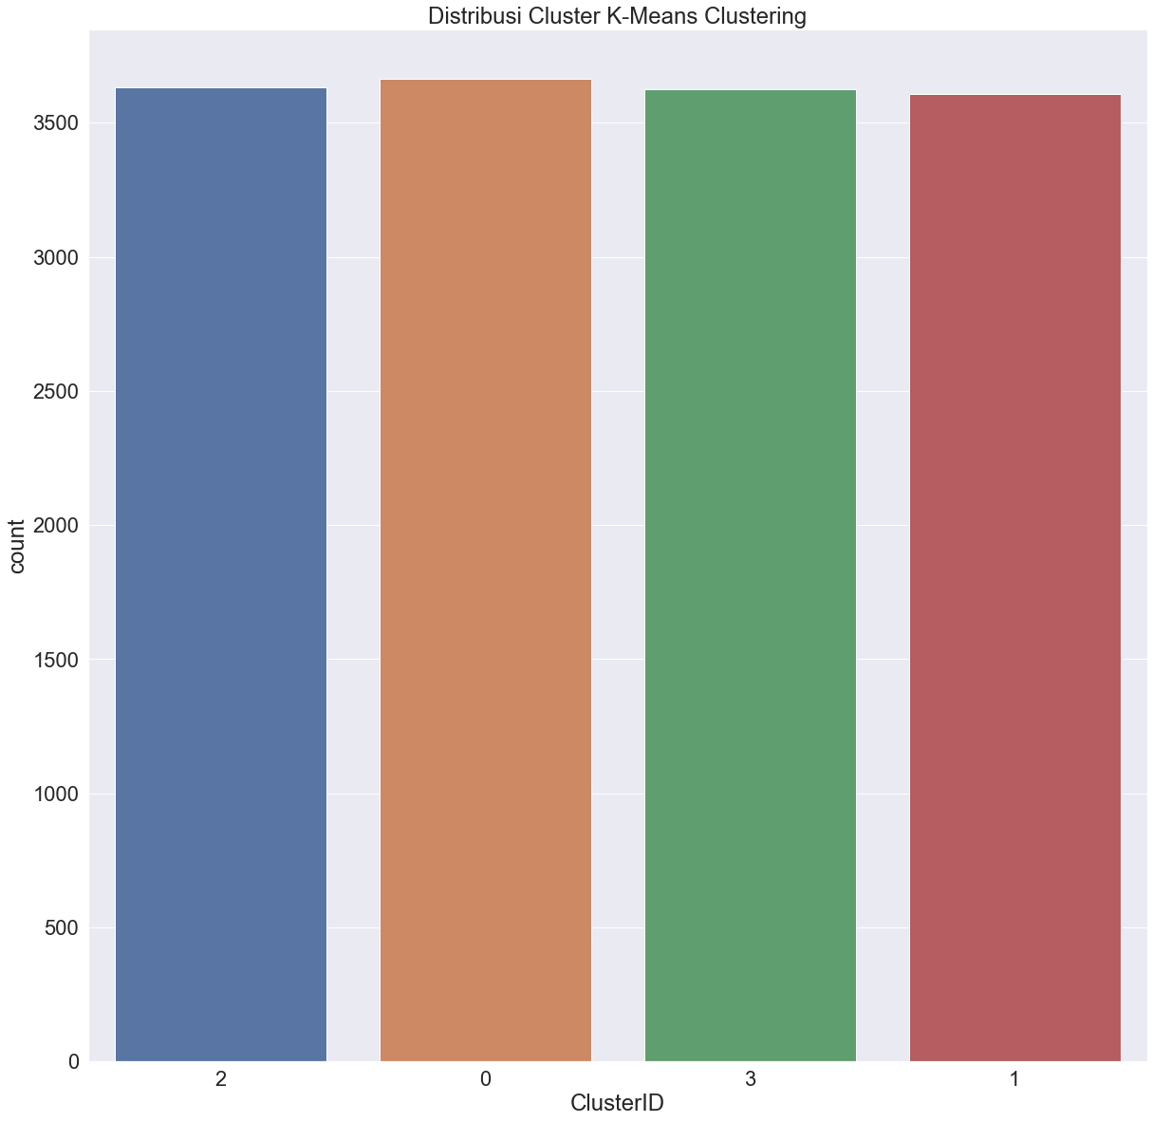
Cluster Distribution

Slide 14
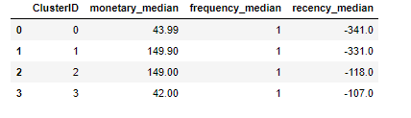
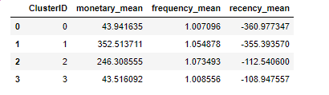
Cluster Statistics
Cluster Median
Cluster Mean
Rank | Recency | Frequency | Monetary
1 | Class 1 | Class 2 | Class 3
2 | Class 2 | Class 1 | Class 2
3 | Class 3 | Class 3 | Class 1
4 | Class 0 | Class 0 | Class 0

Slide 15
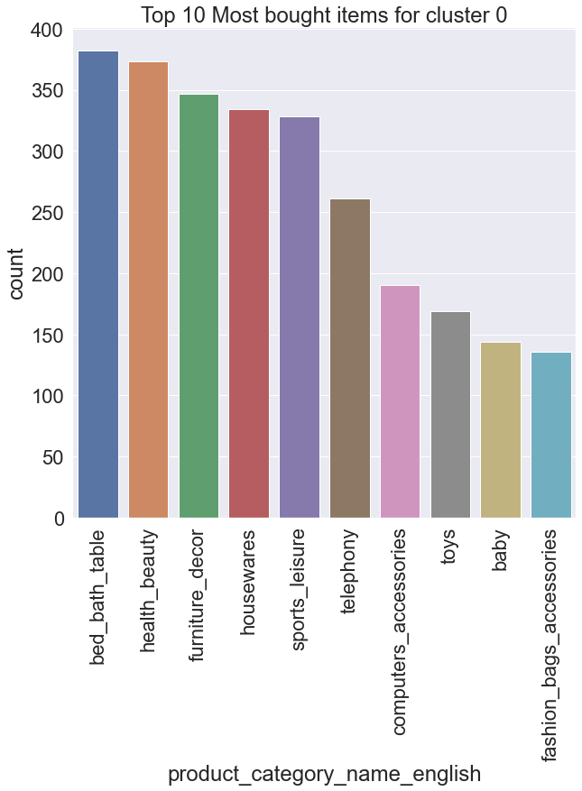
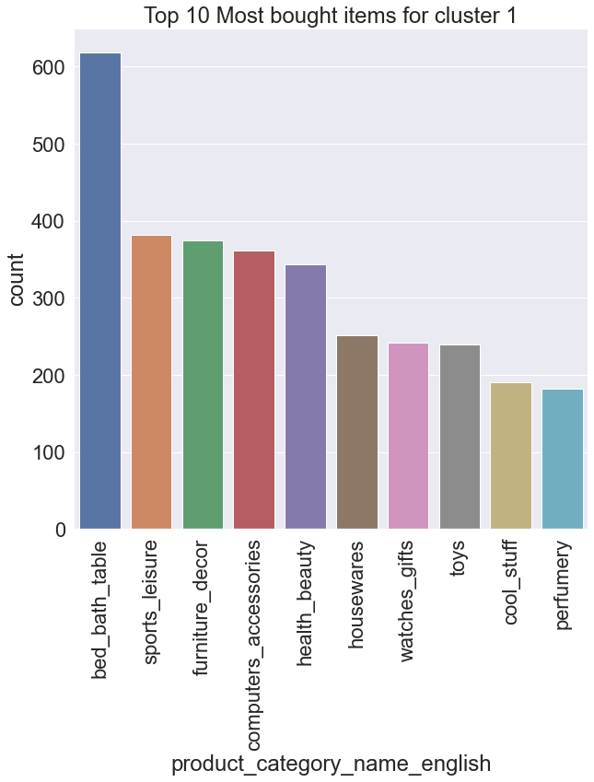
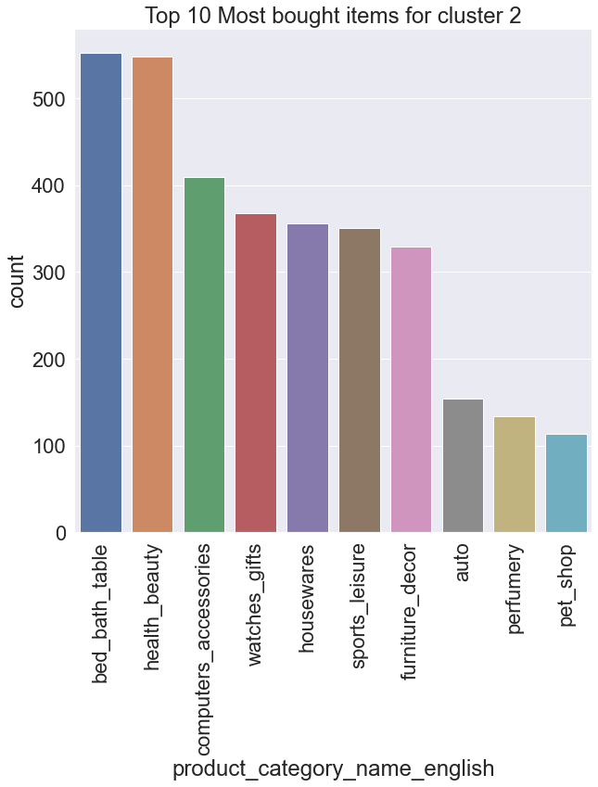
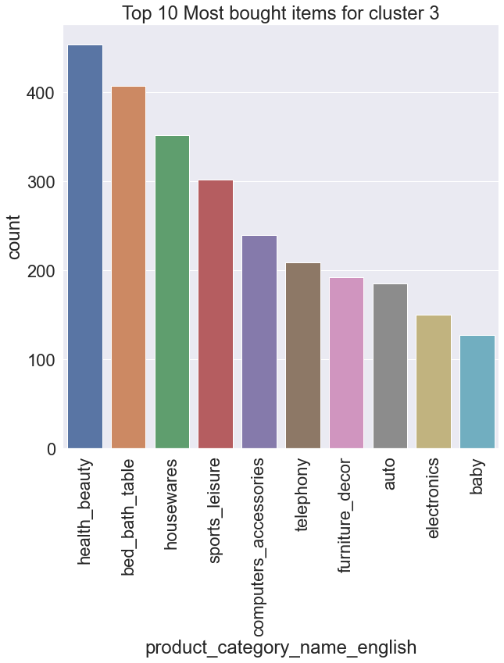
Popular Categories for Each Cluster

Slide 16
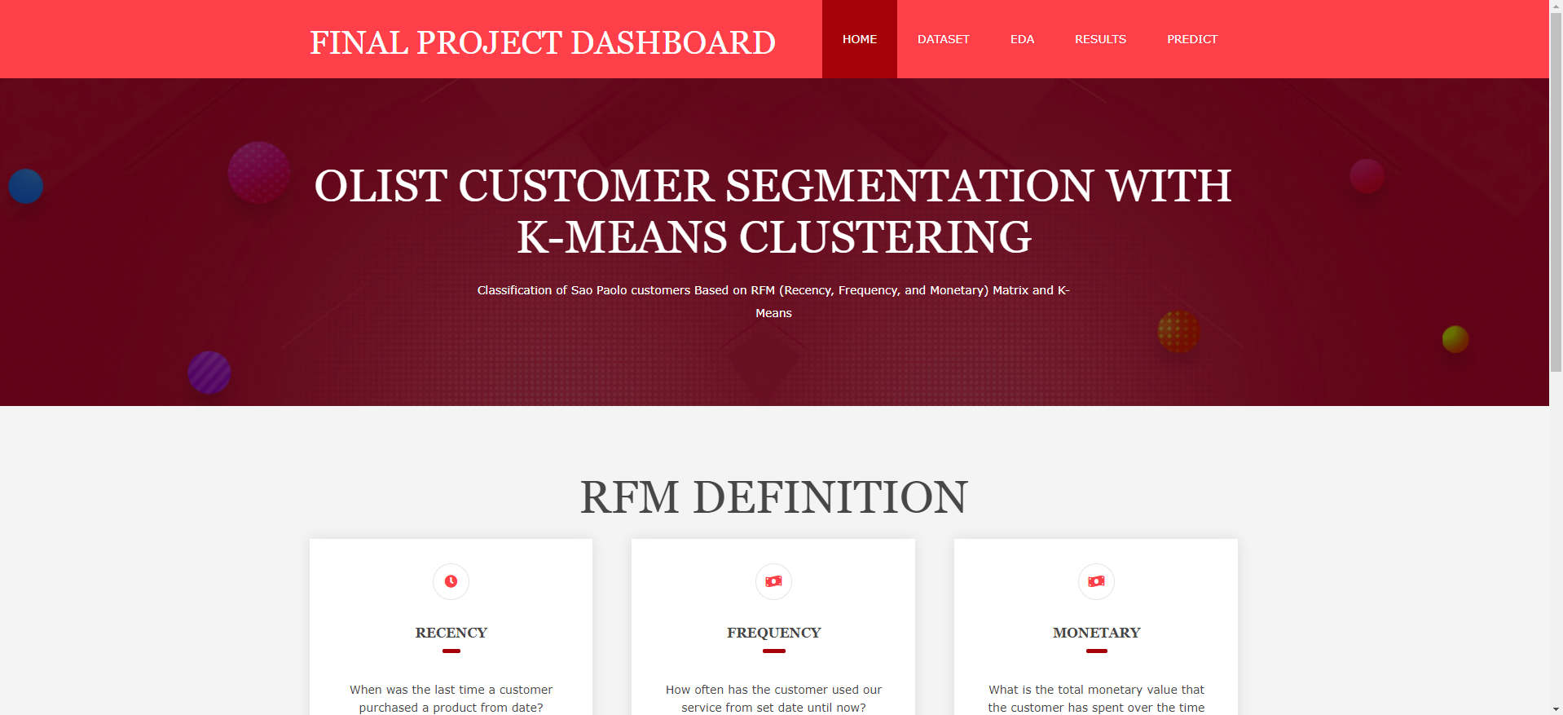
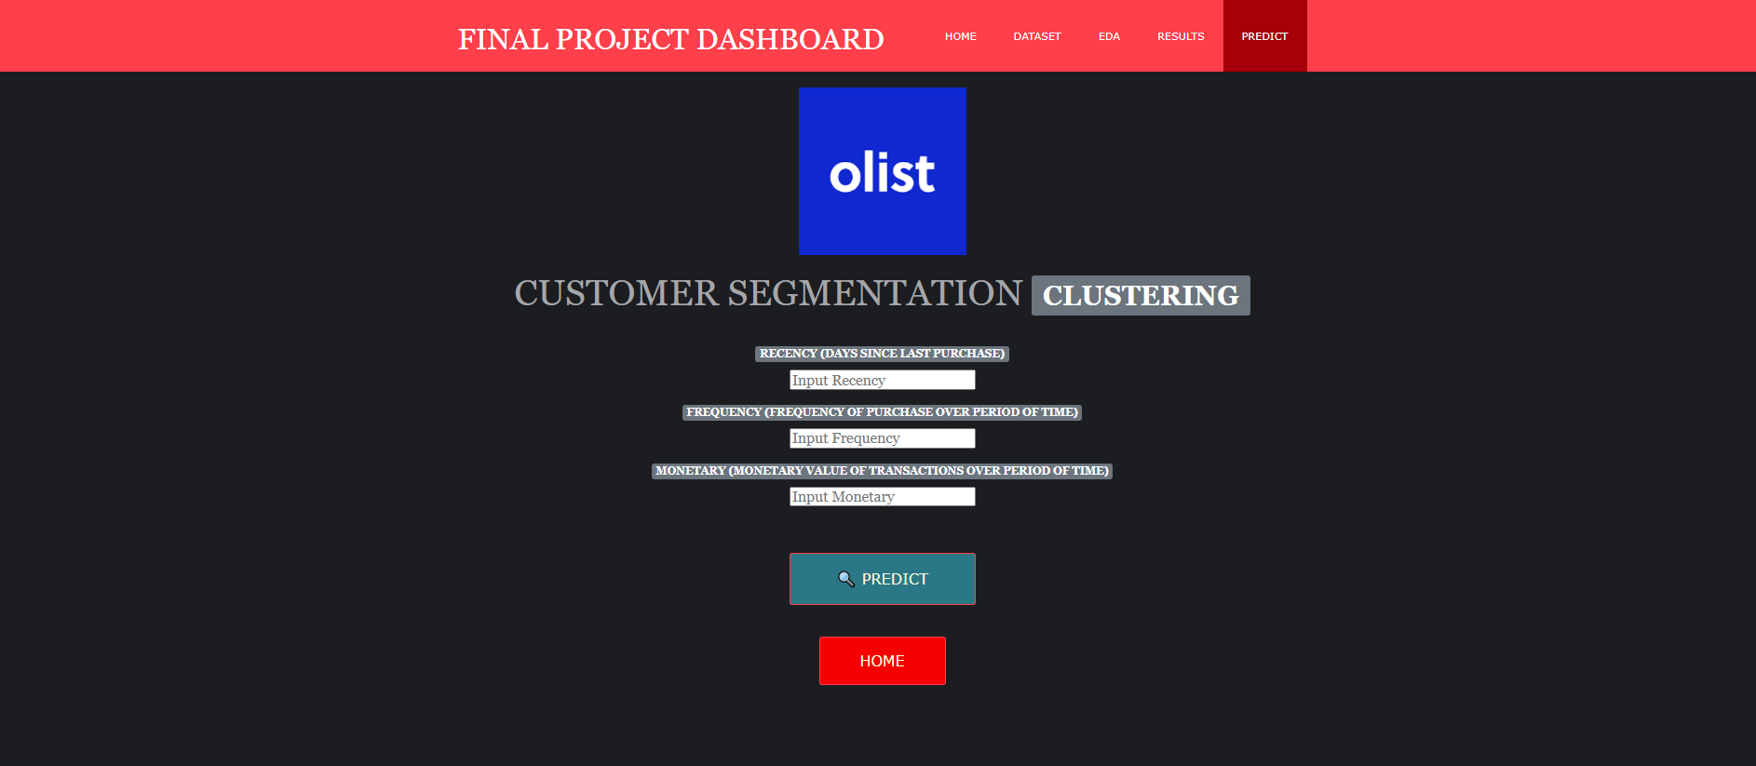
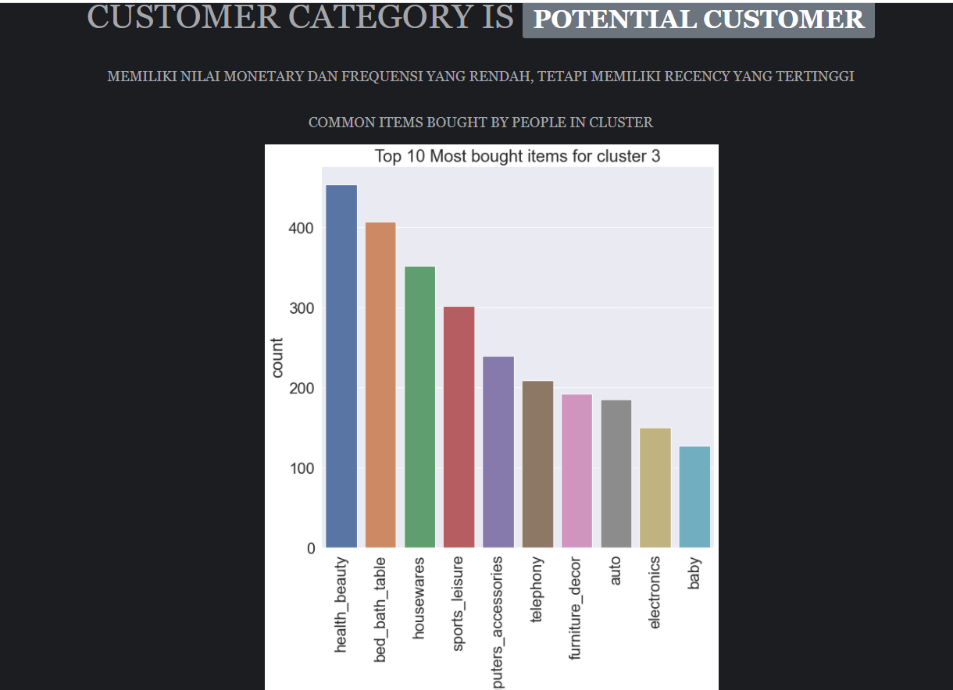
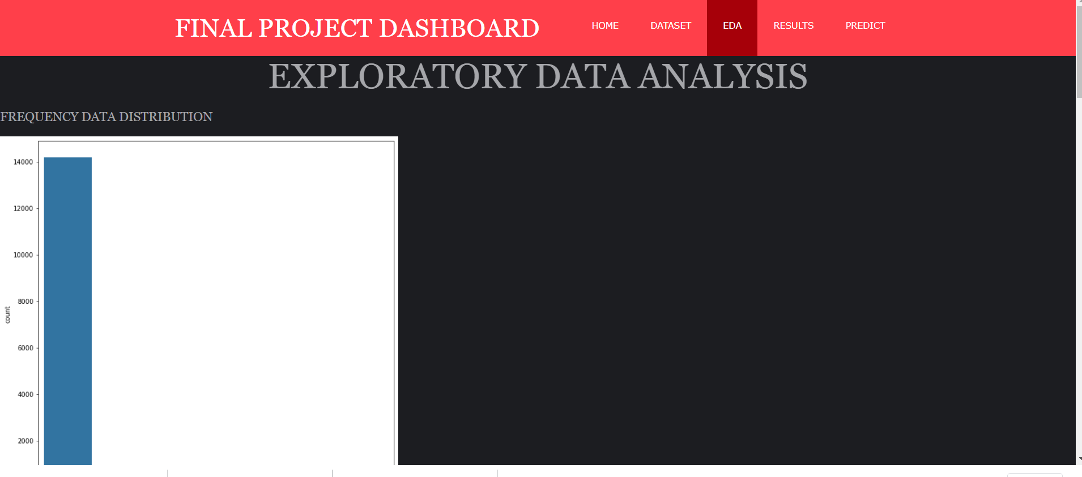
Flask Deployment

Slide 17
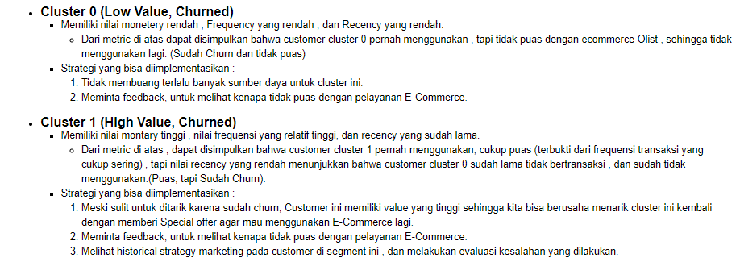
Kesimpulan

Slide 18
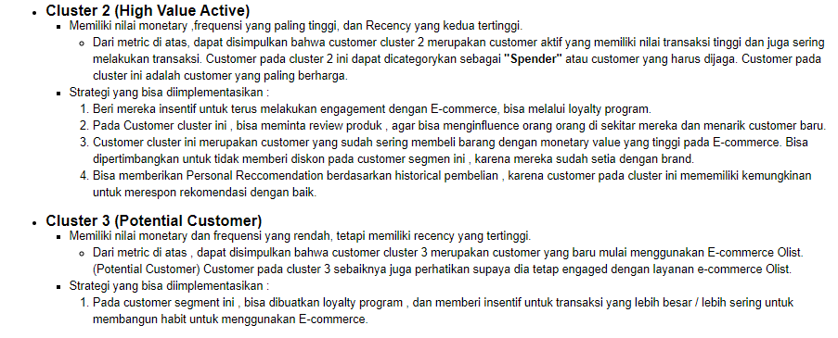
Kesimpulan

